Slide 1

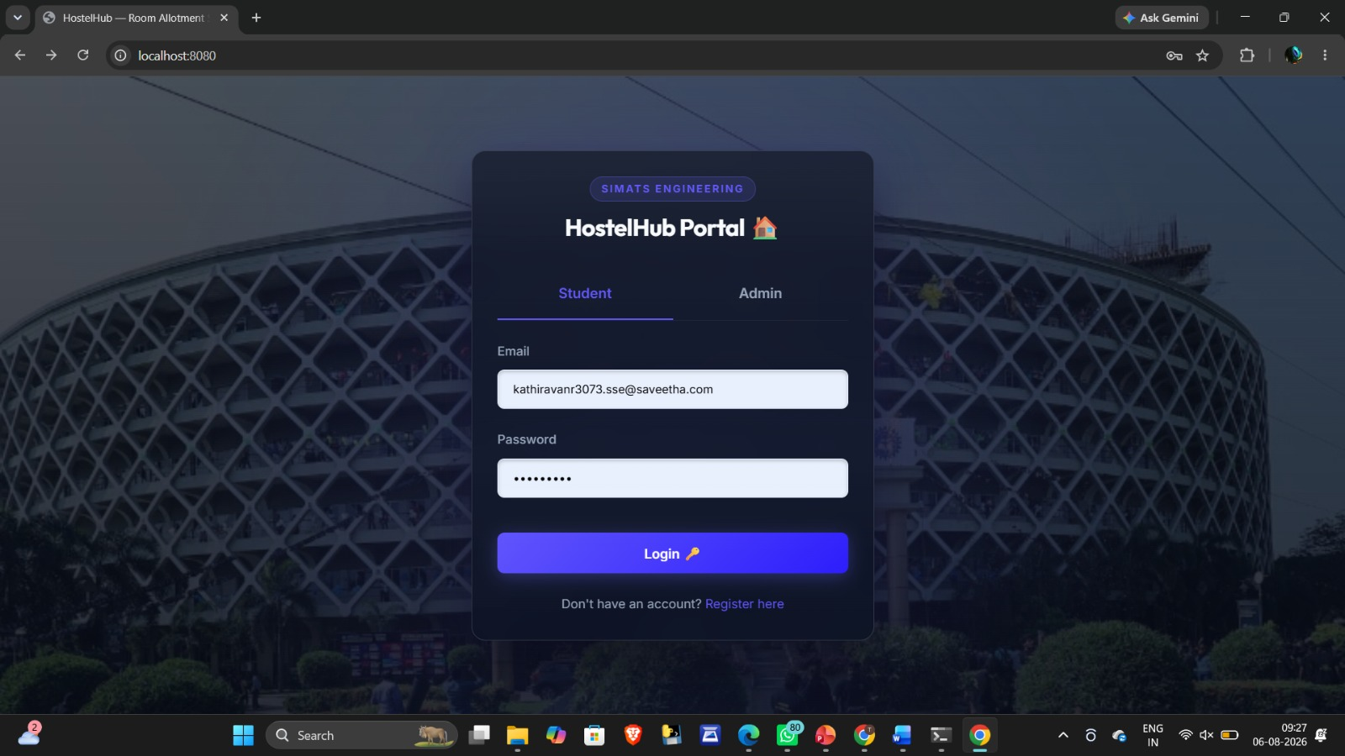
Hostel Room Allotment System
CAPSTONE PROJECT PRESENTATION
Team - 4
Course Code : CSA0209
Course Name : C - Programming
Project work Guided by,
Dr. B. Aberna
Project work done by,
Murugaraj. T (192313072
Kathiravan. R (192313073)

Slide 2


ABSTRACT
Hostel room allotment is usually done manually which consumes time and may result in allocation errors.
This project automates room allocation based on hostel availability and student information.
Main Keypoints of this project, Reduces paperwork Faster allocation Easy student management Maintains hostel records digitally

Slide 3
INTRODUCTION
Project Title: HostelHub – Hostel Room Allotment System
It is a web-based application designed to automate the hostel room allocation process.
The project helps students register, apply for rooms, and check their allotment status online.
It enables administrators to manage student records, room details, and room allotments efficiently.
The frontend is developed using HTML, CSS, and JavaScript.
The backend is developed using C programming, and SQLite is used as the database.
The main goal is to reduce manual work, save time, and improve the accuracy of hostel management.

Slide 4
OBJECTIVES
What This Project Aims to Achieve
1
Automate room allocation based on defined rules (availability, preference)
2
Maintain accurate, persistent student and room records
3
Provide real-time visibility into room occupancy and vacancy
4
Reduce manual errors such as duplicate or conflicting allotments
5
Give admins an easy way to search, allot, and vacate rooms
6
Generate quick reports of hostel occupancy

Slide 5
Problem Statement
1
Time-Consuming
2
Error-Prone
Manually matching students to rooms takes hours and doesn't scale as intake grows.
Duplicate allotments, double bookings, and lost registers are common with paper records.
3
No Real-Time View
4
Hard to Audit
Wardens can't instantly see which rooms are vacant, full, or reserved.
Tracking who stayed where, and for how long, is difficult without digital records.
Hostel room allocation in many colleges is still performed manually, leading to delays, allocation errors, duplicate assignments, and difficulty in managing room availability.
An automated Hostel Room Allotment System is needed to efficiently manage student records, allocate rooms, track vacancies, and maintain accurate hostel information while reducing manual effort and improving overall efficiency.

Slide 6
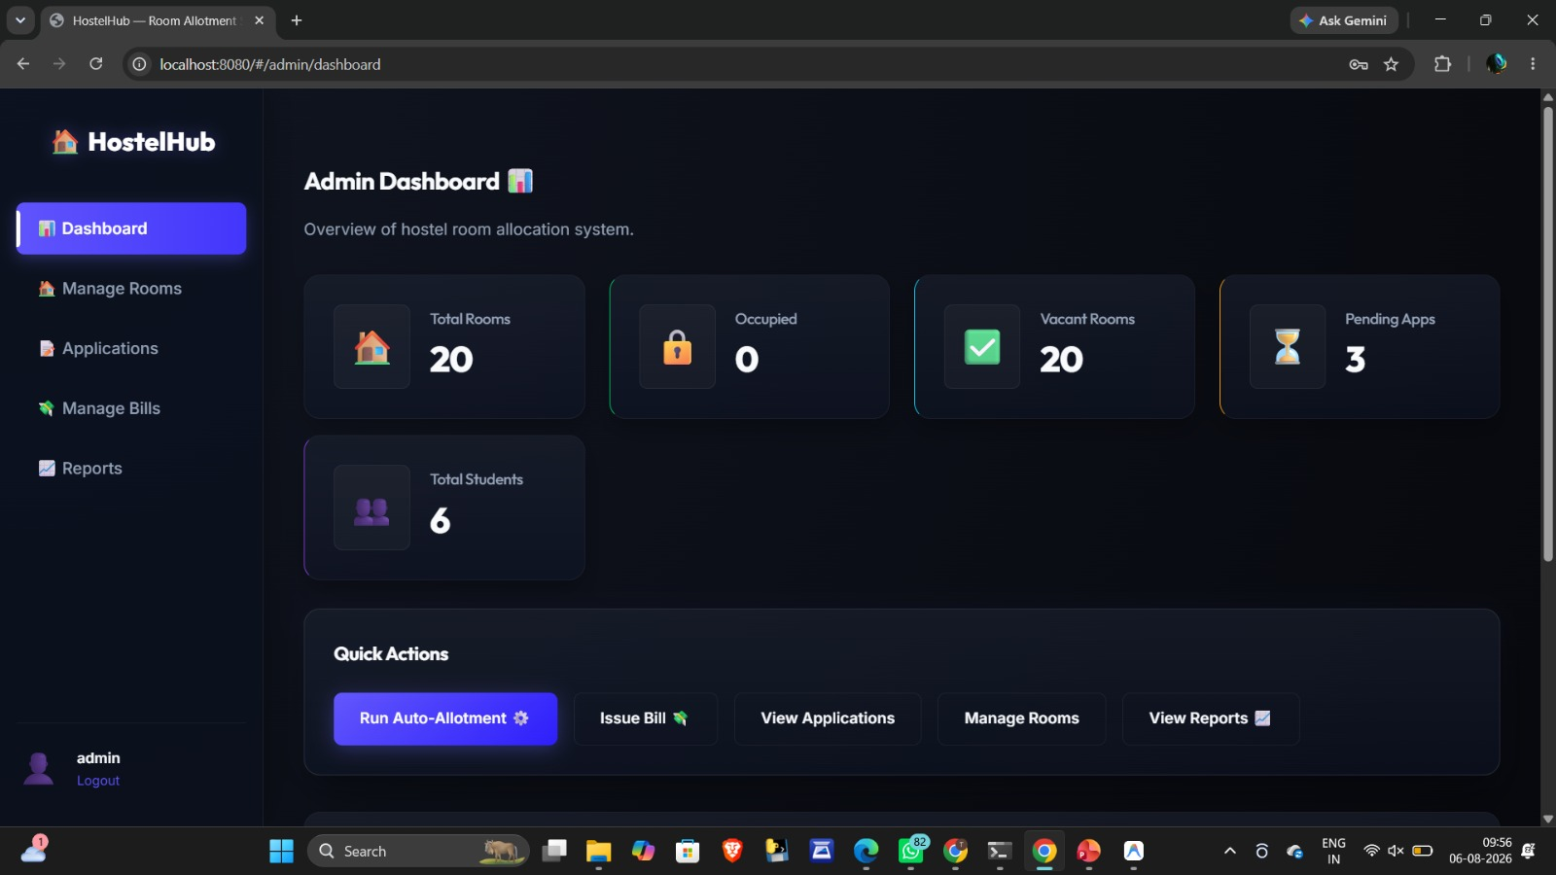
MODULE - 1
Frontend
Used for designing webpages.
HTML
CSS
JavaScript
Purpose
Login page
Registration page
Dashboard
Room selection
Reports

Slide 7
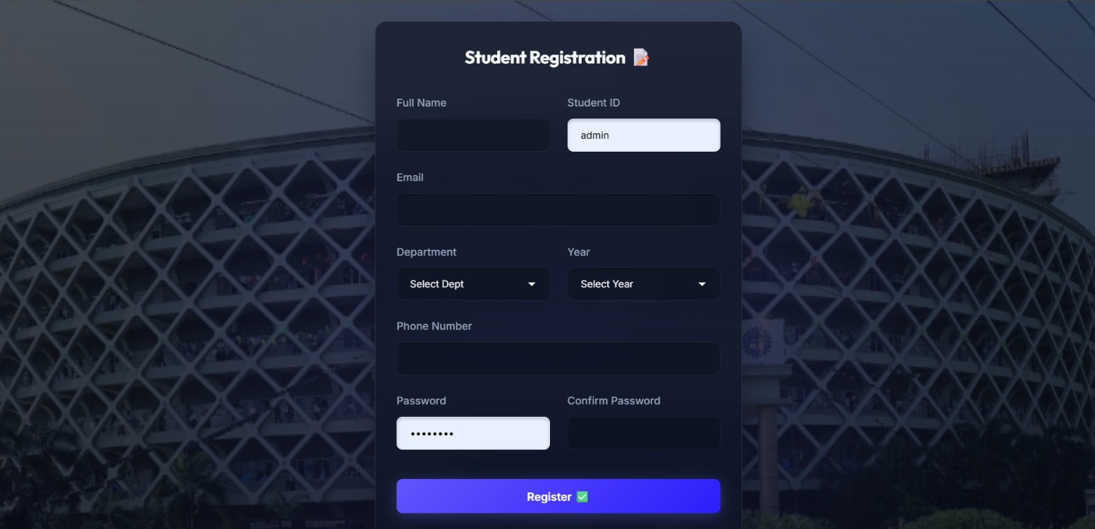
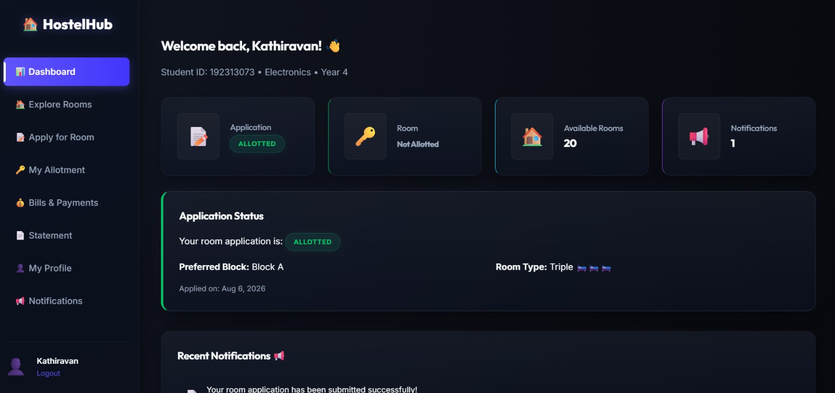
MODULE - 2
Backend
Entire backend is written in C Programming.
Purpose
Receive requests
Validate data
Connect database
Authenticate users
Allocate rooms
Send responses

Slide 8
SYSTEM DESIGN
START
USER (STUDENT/ADMIN)
FRONTEND (HTML, CSS, JS)
SQLite Database Access
LOGIN/REGISTRATION
BACKEND
(C PROGRAM)
END

Slide 9
CORE LOGIC
Data Structures & Allotment Flow
student.h
1
Student submits request via frontend form
struct Student {
int id;
char name[50];
char course[20];
int roomAllotted; // 0 = not allotted
};
struct Room {
int roomNo;
int capacity;
int occupied;
int studentIds[4];
};
2
C backend checks room capacity vs occupied count
3
If space available, room is allotted and record updated
4
If full, backend returns next available room or waitlist
5
Room and student files are updated on disk

Slide 10
FEATURES
Core Modules
1
2
3
Student Registration
Room Allotment
Vacate / De-allot
Capture student ID, name, course, and preferences
Assigns rooms based on availability and rules
Frees up a room and updates records instantly
4
5
6
Admin Dashboard
Search Records
Reports
Login-protected view for wardens/admin staff
Look up a student's room or a room's occupant
View occupancy list and vacant room summary

Slide 11
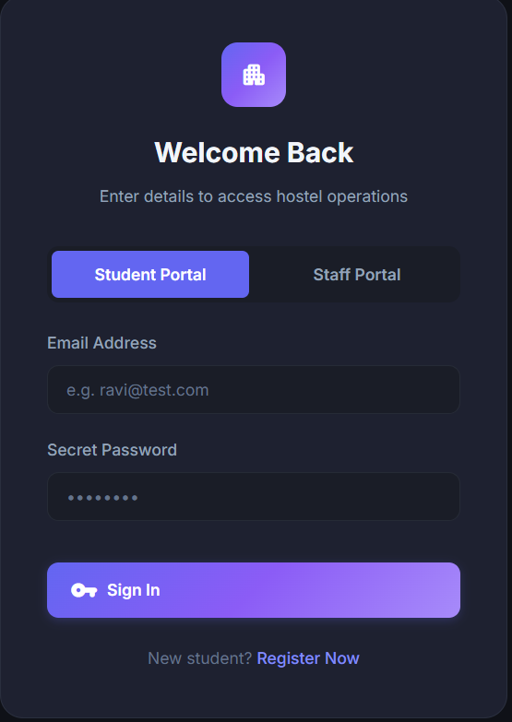
CONCLUSION
A faster, more reliable way
to manage hostel rooms
By combining C's speed and control on the backend with a simple web frontend, this system automates allotment, cuts manual errors, and keeps hostel records accurate and accessible.

Slide 12


